Slide 1
The Role of Ethics in Business

Slide 2

Introduction
Ethics refers to the code of conduct that guides an individual while dealing with others. It deals with what is morally right or wrong
Ethics is related to all disciplines of management within a business such as human resource management and production.
Business ethics involve the behavior, morality, reliability and trust building in the official activities of the business.
Organizations which uphold ethics tend to be the most successful than those which do not follow business ethics.
Notes:
Every person in the world wants to be treated with respect and dignity. Leaders in the businesses are supposed to treat their employees humanly hence promoting their self-esteem levels. (Vazquez, 2018). Workers in a given organization are expected to behave positively by adhering to all rules and ethics embraced in the organizations. Firms which value morality in their operation record higher performance than those which do not have ethics.

Slide 3
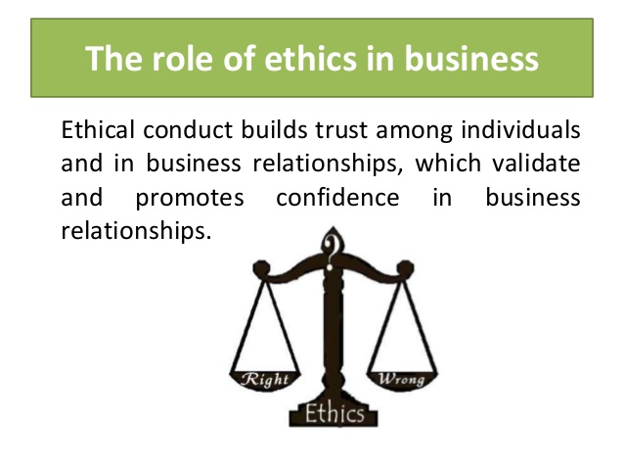
The Role of Ethics in Business
Business ethics encourage trust-building within an organization.
Business ethics helps in formulating a positive organizational culture that leads to peaceful co-existence among the workers.
Adherence to ethics makes an organization to promote the reputation of the firm.
Ethics helps in decision making, where employees must think the right course of action.
Notes:
Trust means freedom given to employees in the business to do what they are interested in doing so long at it reflects the goals of the business. Employees who work in freedom produce better results than those who are always out looked. A positive company culture affords employees respect while expecting excellence in work every day (Chell, Spence, Perrini, & Harris, 2016). With a positive organisational culture, the workers cooperate hence create a competitive environment. Following ethics makes an organisation to boost the status of the firm, therefore, perform better than due to competition among the workers.

Slide 4
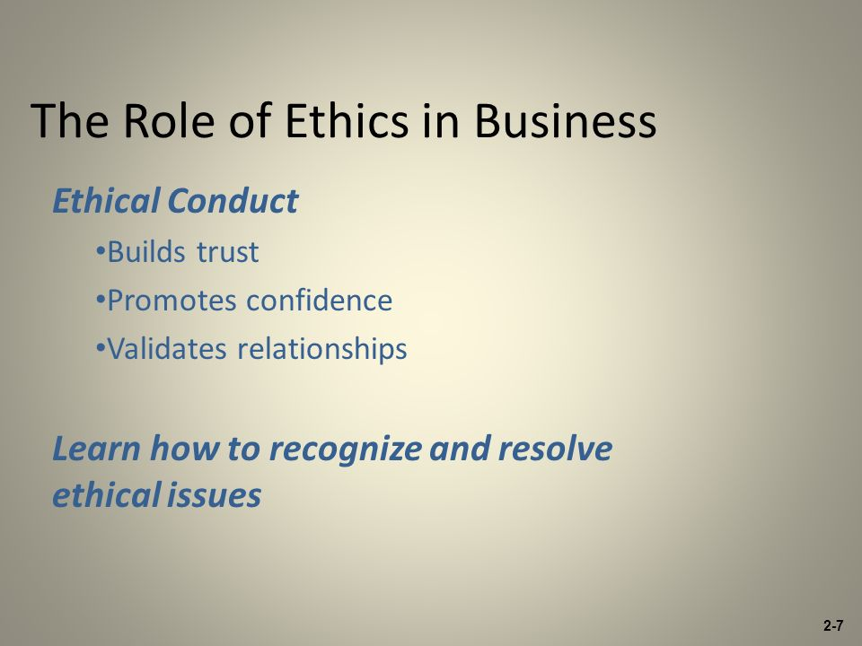
Continuation of the Roles of Ethics in Business…
Morals help attract customers to the firm’s products, thereby boosting sales and profits.
Ethics makes employees stay feel comfortable in the business; therefore, promote confidence in workers.
Attract investors and keep the company’s share price high hence protecting the business profits.
Notes:
A company which is known for logically performing its operations gathers many supporters. Customers want to be respected handled with care. The customers also get to understand how the company operates by building partnerships with its customers (Chell, Spence, Perrini, & Harris, 2016). Additionally, the business does not deviate from the norms of society; hence, their customers feel satisfied. Business ethics promote the quality of the services offered, thus boosting the performance of the business.

Slide 5
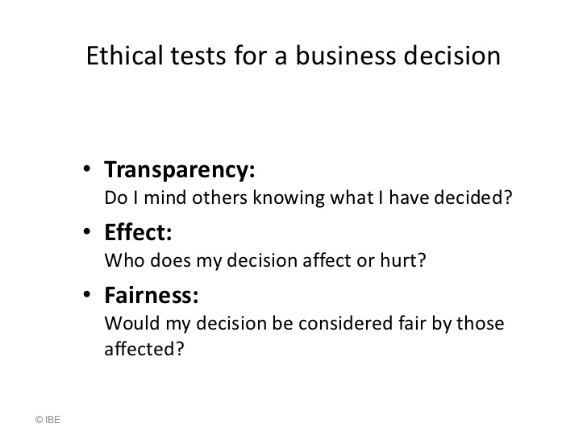
Continuation of the Roles of in Ethics Business…..
Business ethics promote transparency in the employment process as well as in the business activities
The manufacturing process needs principles that stimulate care in the workforce.
Adherence to business ethics motivates the workers to maintain positive relationships hence come up with better solutions to problems.
Notes:
Transparency involves honesty and open communication due to the transparent someone should be willing to share information when it is uncomfortable. Transparency also opens the leaders’ eyes to uphold ethical standards (Vazquez, 2018). Every organisation is faced with challenges; problem-solving power is encouraged by the culture of the organisation. For example, if all workers within an organisation are involved in decision making, better solutions are achieved, thus improved performance.

Slide 6
Conclusion
Ethics plays a very significant role in promoting success in business activities.
Positive environment improves performance of the firm.
Workers perform better when they are given the freedom to take part in decision making within the organization.
Adherence to ethics boosts the reputation of the firm.
Notes:
In conclusion, the leaders in organizations should focus on improving the profits by maximizing their cooperation with employees as well as their customers. Moreover, workers who are allowed to take part in decision making perform better feel that they belong in the organisation hence make better results. It is essential for business persons to focus on following business ethics to boost the image of their firms, consequently realize better profits (Vazquez, 2018).

Slide 7
References
Chell, E., Spence, L. J., Perrini, F., & Harris, J. D. (2016). Social entrepreneurship and business ethics: Does social equal ethical?. Journal of business ethics, 133(4), 619-625.
Vazquez, P. (2018). Family business ethics: At the crossroads of business ethics and family business. Journal of Business Ethics, 150(3), 691-709.

